Slide 1

AI in Trauma Healing
Michelangiolo Mazzeschi
Thanks to:

Slide 2
Background
Creating AI models for Real Estate funds
Finance Background
Experienced in ML and DL

Slide 3
Why talk about Trauma?
Worked for a psychologist for 7 months, created Big 5 Models
Now that I know AI, I can mix the two things
Are there existing models/software?

Slide 4
This PPT
What is a trauma
How to heal it
Existing software on traumas
How would I build an AI that does that
Issues and Limitations

Slide 5


Framework of Interpretation of Reality
wrong framework
2 year old
5 year old
Complexity

Slide 6
Phenomenology Issue
No longer valid
No longer valid
No longer valid
Past
Present
Future
Notes:
Ex. Being Adopted

Slide 7
Intensity of Traumas
Trauma_1
Trauma_2
Unprocessed
Thoughts
Traumas
PTSD
Exposure to Complexity

Slide 8
Methods of Trauma Healing (not counting any pharmacological approach)
EMDR_Eye Movement Desensitization and Reprocessing
Behavioral Therapy

Slide 9
Behavioral Therapy – How trauma is healed an why
Exposure to one’s fears
Complex emotion is processed through language
Multiple traumas are healed progressively
Person become’s stronger every time

Slide 10
2010
2015
2020

Slide 11
How is normal therapy conducted?
Understanding the trauma
Make the person talk about it (in a general way)
Analyze sensible points (get to specific parts)
Make the person articulate – Emotional Reaction
Progress in intensity

Slide 12
Does it always work?
Competence of Psychologist
Patient commitment
Patient response – Mediated by the environment

Slide 13
James W. Pennebaker Research
Initially studying relation between traumas and physical health
People who keep traumatic event secret have SIGNIFICANTLY higher chances of getting sicker
Expression improves, and improvements can be measured
Developed the LIWC 2015

Slide 14
LIWC_2015
Created 80 categories of words (ex. Positive Emotions, Negative Emotions, Anger Words...)
People improve not depending on the content they write, but HOW they write it
Category of Function Words act as the best predictor of improvement

Slide 15
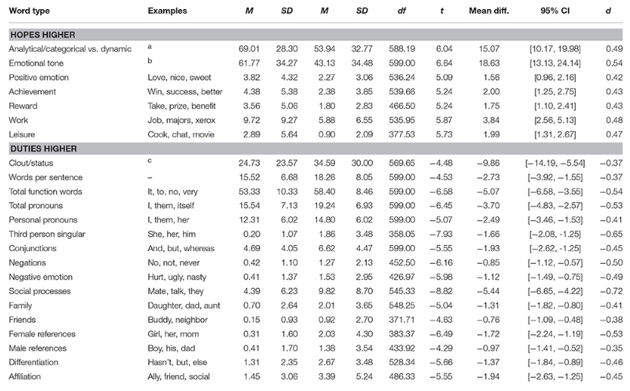
LIWC_2015
Text
_______________________________
_______________________________
_______________________________
_______________________________
_______________________________
_______________________________
_______________________________
_______________________________
_______________________________

Slide 16
Trauma Experience → Data

Slide 17
AI application on trauma
Existing: assessing trauma
Missing: autonomous software
has to act in a generalized way

Slide 18
Big 5 personality Model
Openness
Conscientiousness
Extraversion
Agreeableness
Neuroticism

Slide 19
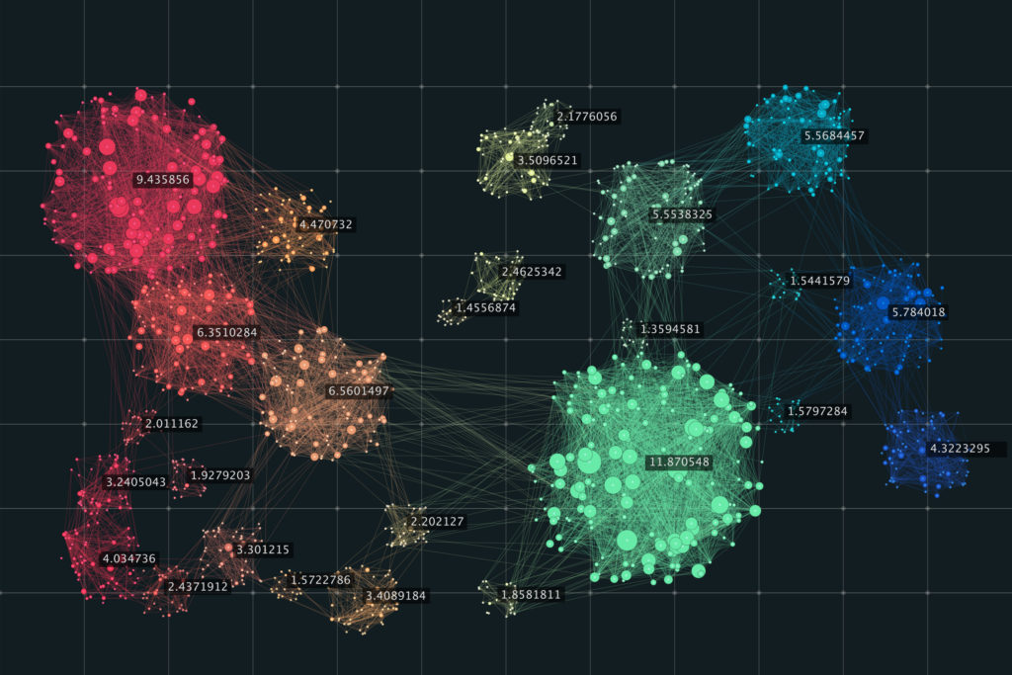
Clustering
Country
Personality
Intelligence
Social Status
...

Slide 20
 | Openness | Conscientiousness | Extraversion | ...
person_1 | 80 | 110 | 70 | ...
person_2 | 30 | 100 | 62 | ...
person_3 | ... | ... | ... | ...
person_4 | ... | ... | ... | ...
person_5 | ... | ... | ... | ...
person_6 | ... | ... | ... | ...
person_7 | ... | ... | ... | ...
person_8 | ... | ... | ... | ...
person_9 | ... | ... | ... | ...
... | ... | ... | ... | ...

Slide 21
Trauma Expression, relevant information
Written Text
Speech (Content + Tone)
Facial Expressions

Slide 22
Listing the Traumas
2010
2015
2020

Slide 23
Estimating the impact (LIWC_2015)
2010
2015
2020

Slide 24
NLP Analysis
Inference
Perform:
- Part of Speech
- Extract Context
Text
_______________________________
_______________________________
_______________________________
_______________________________
_______________________________
_______________________________
_______________________________
_______________________________
_______________________________
Generate Question
Emotional Reaction
Sensible Content
Previous Data
Notes:
Thanks to data of other user, we can recognize easily what might be sensible content for the new subjects

Slide 25
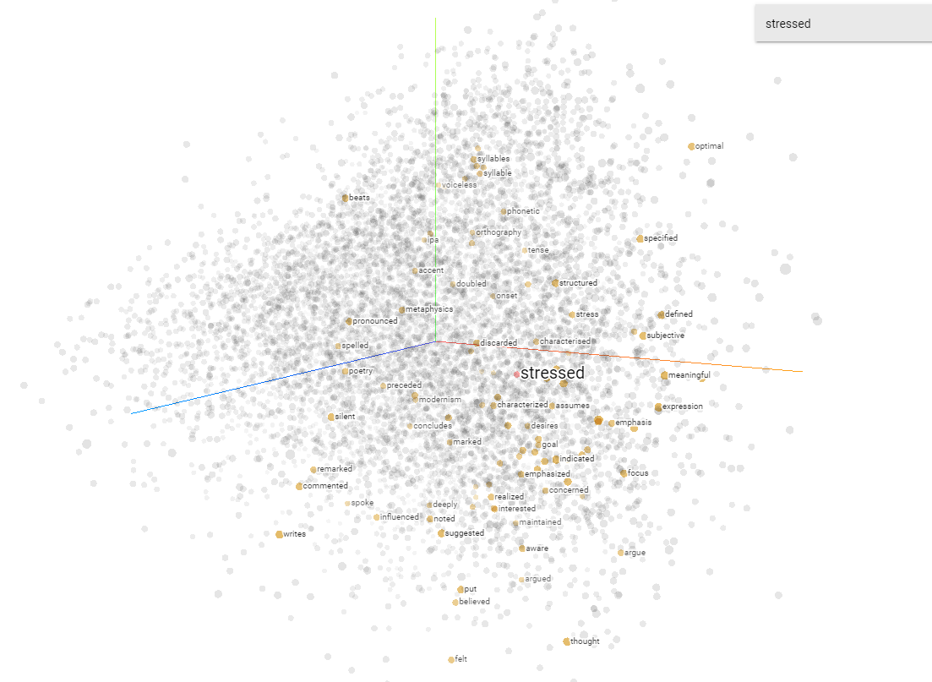

Slide 26
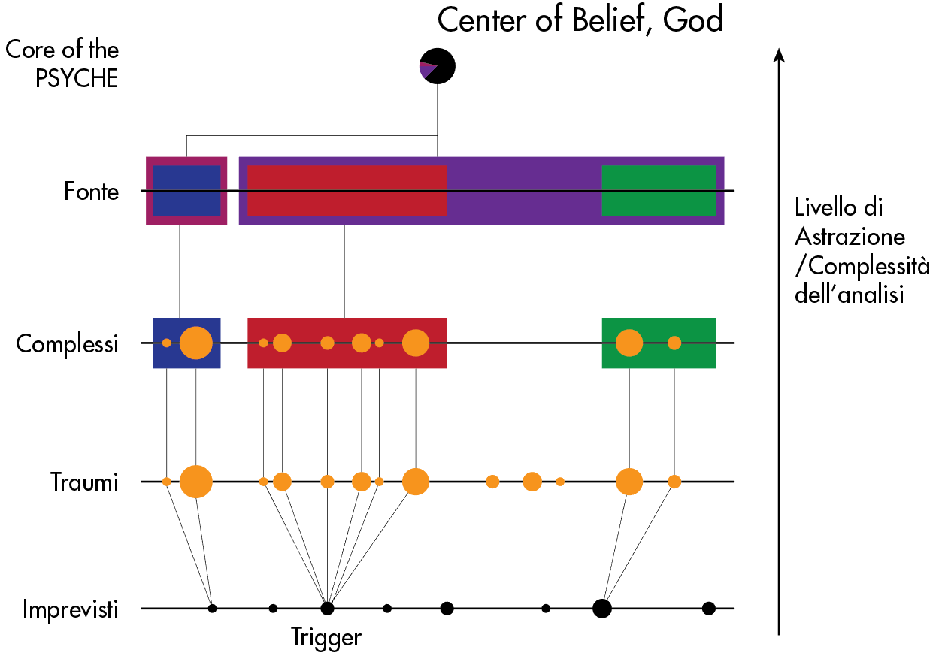

Slide 27
Problems in achieveing this
Traumas are intersected with Depression
Data Collection
What if the AI makes the problem worse?

Slide 28
Isolated Traumas

Slide 29
Real Life

